Slide 1
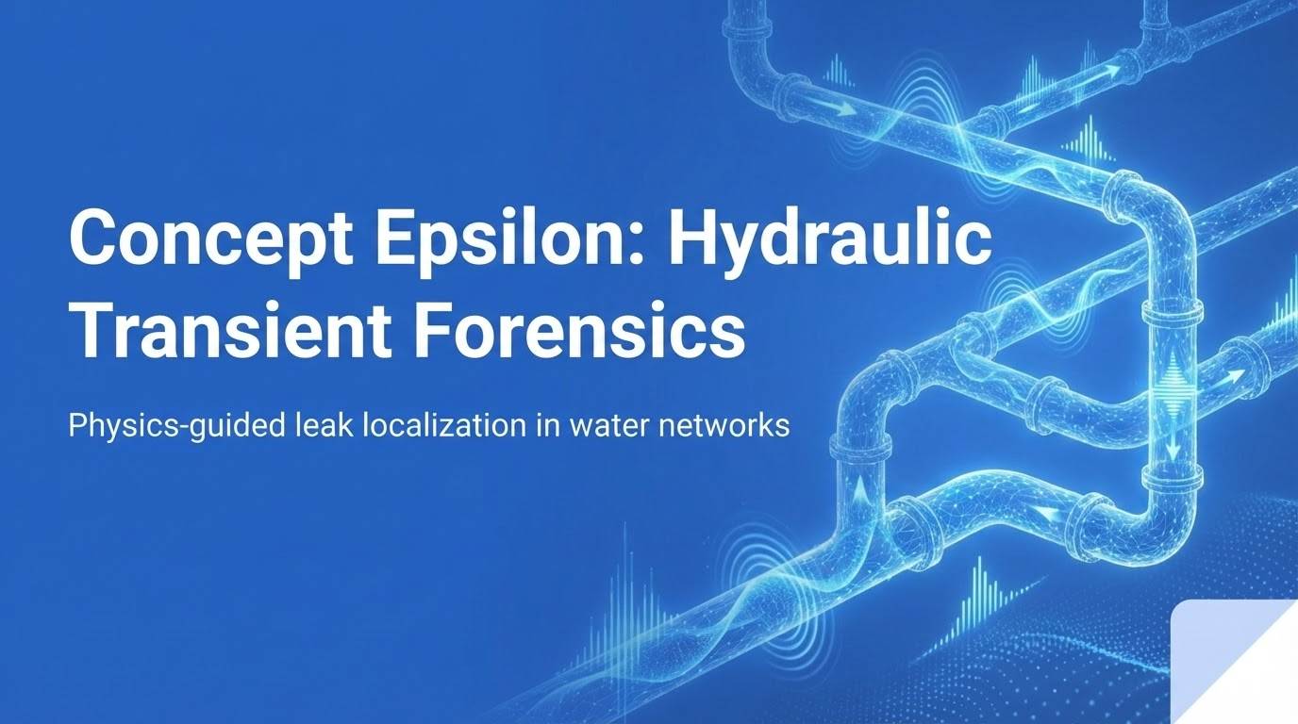

Slide 2
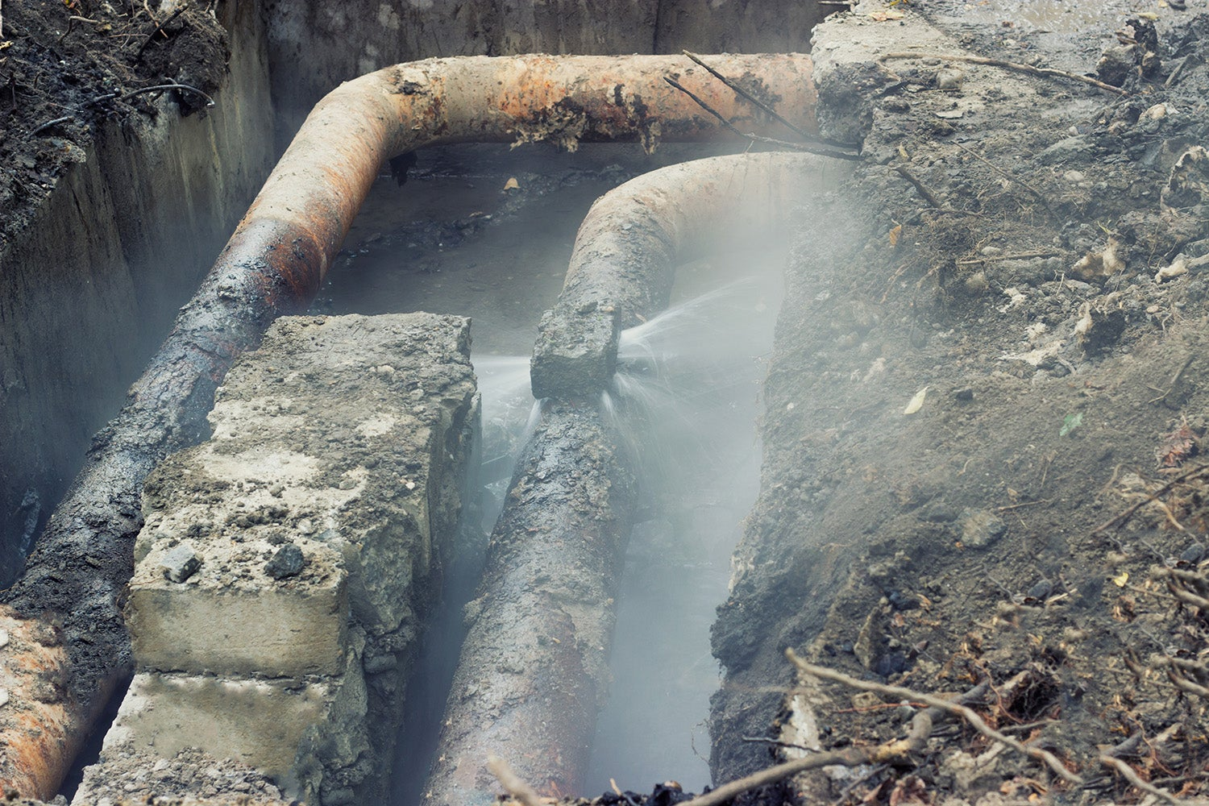
The Real World Problem: Invisible Non-Revenue Water
Water utilities lose 20–30% of treated water to leaks and bursts.
Most leaks stay underground for weeks or months before anyone sees water.
Every day the leak continues, utilities pay for pumping and treatment that never reaches customers.
Non-revenue water is a multi‑billion‑dollar problem and a climate/energy problem.
Current monitoring is good at slow pressure and flow trends, but blind to fast transient events.
!

Slide 3
Why Existing Leak Detection Falls Short
Manual acoustic surveys: crews walk the network listening for leaks.
Slow: you might survey a zone only once or twice a year.
Labor intensive and dependent on operator skill and noise conditions.
Dense logger deployments: many permanent loggers linked by radio.
High capex/opex: hardware, maintenance, communications.
Still often reactive, not tied to the physics of a specific event.
Net effect: utilities see the consequences (lost water, bursts) but not the hidden hydraulic signals.

Slide 4
Our solution: Use Transients as a Built-In Leak Sensor
Any rapid pump stop or valve closure launches a water hammer pressure wave.
That wave travels through the network and is distorted by leaks (changed impedance).
These events already happen during normal operations and maintenance.
Concept Epsilon turns those events into controlled 'pings' of the system.
We read the waveforms at a few sensors and solve an inverse physics problem to find the leak.
In short: use existing infrastructure as a distributed leak sensor, via math and simulation.

Slide 5
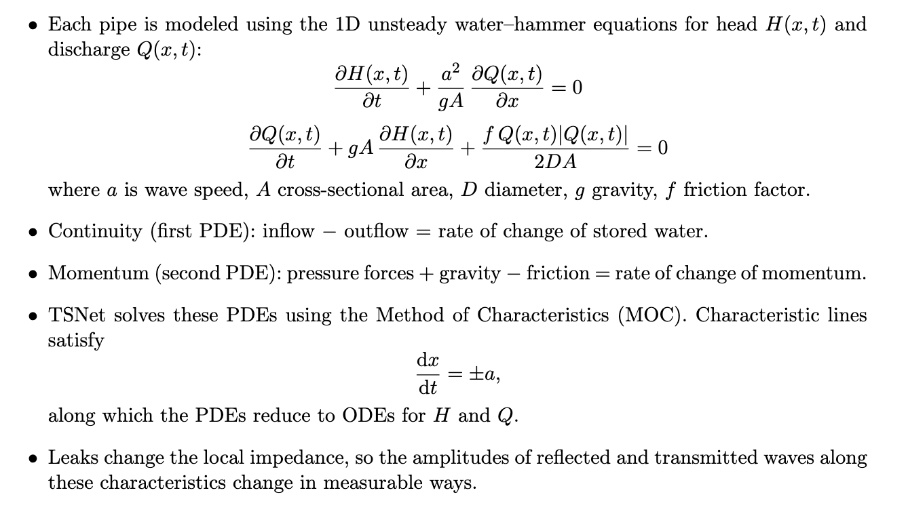
Physics Core: 1D Water Hammer in Pipes

Slide 6
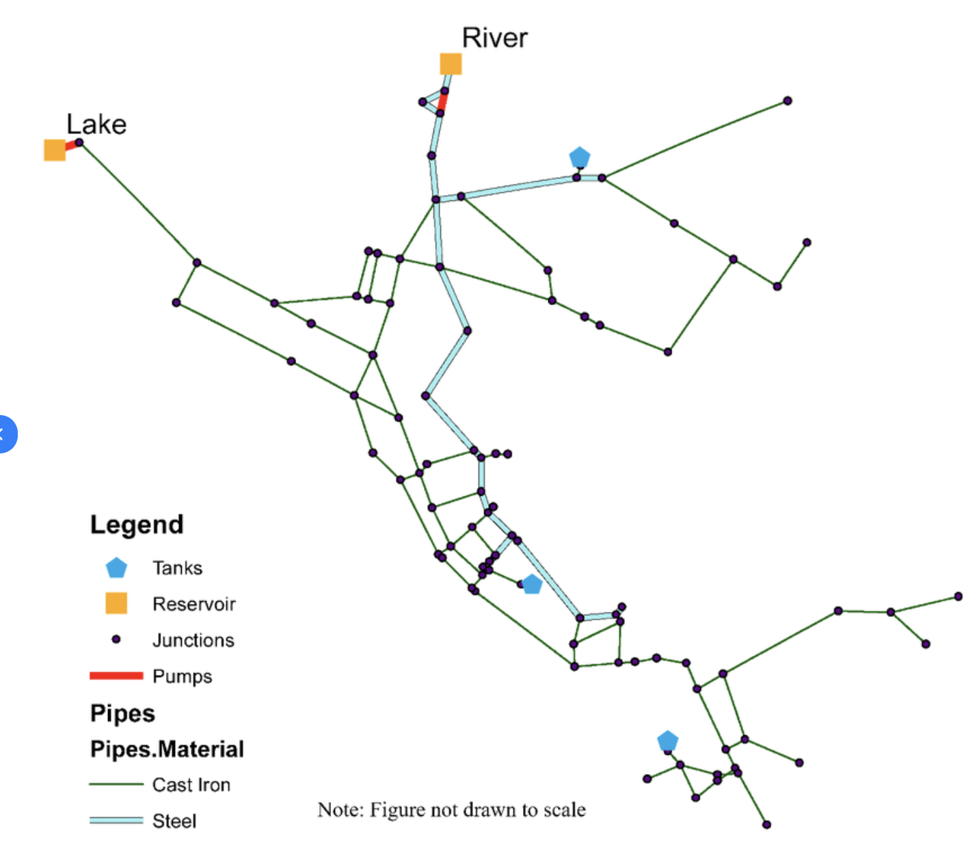
Digital Twin, Excitation Event, and Data
Start from the utility’s EPANET .inp model: pipe topology, diameters, roughness, demands, and boundary conditions.
TSNet wraps EPANET to build a transient-capable digital twin that simulates water-hammer waves.
Define a repeatable excitation event (e.g., rapid valve closure or pump shutdown) that acts as an active “ping” through the network.
High-frequency pressure loggers (100–1000 Hz) at a small set of junctions record head H(t) during each event.
Each event produces multichannel pressure waveforms x(t) that form the raw input data for leak localization.
Example of EPANET network graph.

Slide 7
Synthetic Leak Library: Solving the Forward Problem
Forward question: if a leak of size C_e occurs in pipe p, what pressure trace y(t) do sensors see?
We model leaks as emitters or leak nodes with Q_leak ≈ C_e * H^m (orifice‑like flow).
For each candidate pipe and leak size:
Insert leak into the digital twin.
Run the same excitation event with TSNet.
Record high‑frequency pressure traces at sensor nodes.
Each simulation becomes one labeled example where:
x=multichannel pressure vs time;
y=leak pipe id or “no leak”
This library is physics generated ground truth for training the inverse model.

Slide 8
Learning the Inverse: 1D CNN Leak Locator
Inverse question: given sensor waveforms x(t), which leak (if any) explains them best?
We approximate the inverse mapping with a 1D convolutional neural network.
Input: matrix of pressure vs time at a small set of sensors (channels × timesteps).
The CNN learns wave 'fingerprints': arrival times, reflections, decay patterns per leak location.
Output: probability distribution over {no leak, pipe_1, pipe_2, ...}.
Training: cross‑entropy loss on synthetic library, Adam optimizer, early stopping.
Result: fast, one shot leak localization once the model is trained.

Slide 9
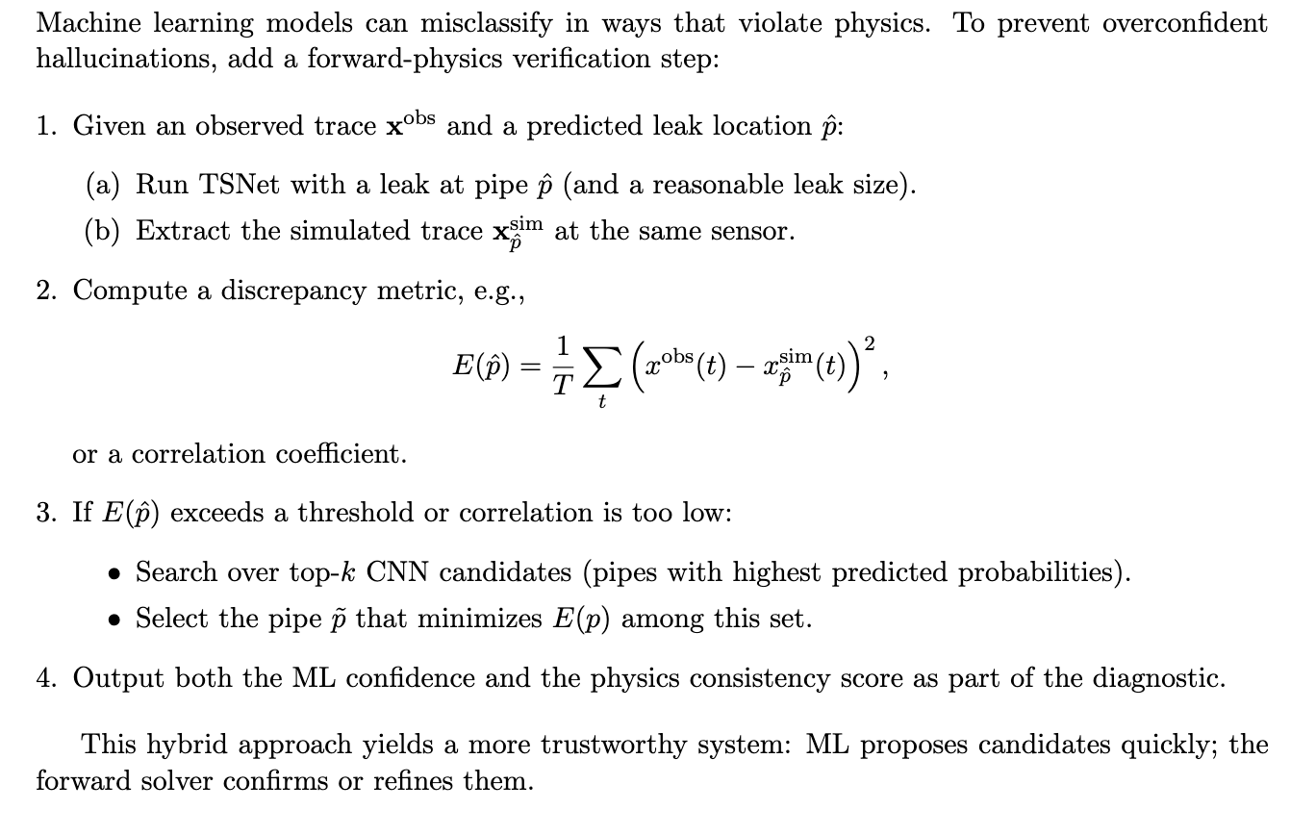
Physics-Consistency: How we Keep the Model Honest

Slide 10
From Problem to Working System
Backend: FastAPI + TSNet engine + PyTorch CNN + physics‑consistency layer.
Frontend: React/Vite dashboard visualizing network, leaks, and waveforms.
Flow in demo and deployment:
1) Run a planned valve/pump event, record high‑frequency pressure at sensors.
2) Feed traces into Concept Epsilon API.
3) CNN proposes leak locations; TSNet verifies via forward simulations.
4) Dashboard highlights most likely leak pipes and shows waveform match.
Outcome: transforms invisible physics into actionable leak locations for utilities.

Slide 11
Path to Implementation and Growth
Phase 1 – Offline pilot
Take an existing EPANET model and historical event data.
Calibrate the digital twin, generate the leak library, and validate on past leaks.
Phase 2 – Assisted operations
Schedule a small number of controlled pump/valve events per week.
Run Concept Epsilon in parallel with current workflows, surfacing top leak candidates for crews.
Phase 3 – Integrated service
Package the system as a cloud or on-prem API connected to the utility’s SCADA and modeling tools.
Provide dashboards, alerting, and reporting on leak risk hotspots.
Long-term growth
Extend to pressure-management optimization, burst early-warning, and asset-risk scoring.
Generalize the same inverse-physics framework to district heating, gas, or industrial pipelines.

